Slide 1
IBM University Engagement Project Submission
“Exploring the Power of Agentic AI with IBM Granite and IBM Bob”

Slide 2

[Travel Planner Agent]
Project Tile –
Domain of Project –
[ Transportation ]
Student Name | Recent Passport Photo | Email ID | Mobile number [WhatsApp]
CHOKKA. ABITHA KISHORE |  | abithachokka@gma il.com | +919030282169

Slide 3
Problem Statement -
Problem Statement : Travel Agent
The Challenge :
A Travel Planner Agent is an AI-powered assistant that helps users plan trips efficiently and intelligently.
The Objective:
To develop an AI-powered India Travel Agent that helps users plan personalized trips across India by providing destination recommendations, customized itineraries, budget estimation, travel suggestions, and interactive assistance through an intelligent conversational interface.
Develop an intelligent travel planning platform for India.
Generate personalized travel itineraries based on user preferences.
Provide budget estimation and trip planning assistance.
Recommend suitable destinations, activities, and travel options.
Enable users to interact with an AI-powered travel assistant.
Provide a professional, responsive, and user-friendly web interface.

Slide 4
Proposed Solution -
Proposed Solution: AI-Powered India Travel Agent
The proposed solution is an AI-powered India Travel Agent designed to provide personalized, intelligent, and interactive travel planning assistance using IBM watsonx.ai, IBM Bob, and Granite Models.
The system addresses common challenges in travel planning such as destination selection, itinerary creation, budget
management, and personalized recommendations.
At its core, the solution uses an AI-powered conversational interface to understand user requirements and generate customized travel plans based on destination, duration, budget, and travel preferences.
The system provides the following key capabilities:
Destination Recommendation Agent – Suggests suitable Indian destinations based on user interests, budget, duration, and travel style.
Itinerary Planning Agent – Generates structured day-wise travel itineraries with recommended places, activities, and
schedules.
Budget Planning Agent – Provides estimated trip costs and organizes expenses according to the user's selected budget.
Travel Information Agent – Provides useful information about destinations, attractions, seasons, activities, and travel tips.
AI Conversational Assistant – Enables users to interact naturally with the travel agent and refine their trip plans through conversation.
The solution includes a professional, responsive web dashboard that displays the generated itinerary, trip overview, budget summary, travel tips, and AI responses in an easy-to-understand format.
IBM Bob is used to assist in application development and workflow orchestration, while IBM watsonx.ai and Granite
Models provide the AI capabilities for understanding user requirements, generating recommendations, and creating personalized travel plans.
Overall, the solution delivers an end-to-end intelligent travel assistant that simplifies India travel planning through personalized recommendations, itinerary generation, budget assistance, and conversational AI.

Slide 5
Technology Used
IBM Bob – For AI-assisted application development, code generation, and designing the application
workflow.
IBM watsonx.ai – For integrating and utilizing AI models to power intelligent travel assistance and content generation.
IBM Granite Models – For natural language understanding, reasoning, and generating personalized travel recommendations and itineraries.
Python & Flask – For developing the backend services and handling API requests between the web application and AI services.
HTML, CSS & JavaScript – For building the responsive and user-friendly travel agent interface.
RAG (Retrieval-Augmented Generation) – To retrieve relevant travel information and provide more accurate and context-aware responses.
REST APIs – For communication between the frontend, backend, and AI services.
Responsive Web Design – To ensure the Travel Agent works effectively across desktop, tablet, and mobile devices.

Slide 6
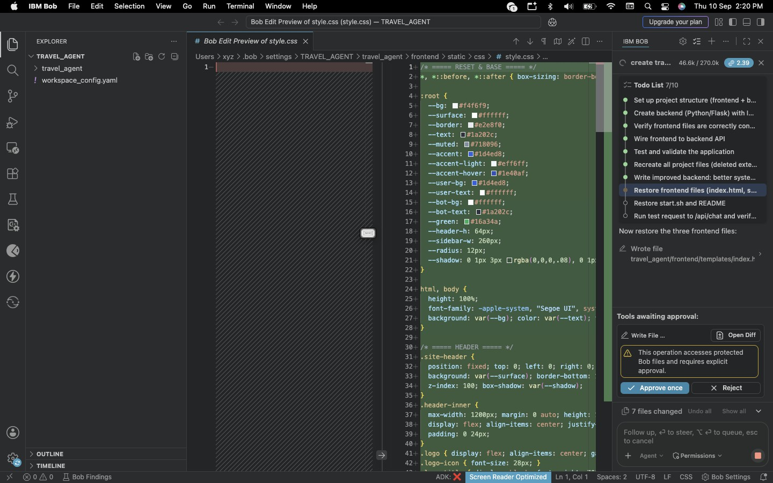
Required Files created using IBM bob -

Slide 7
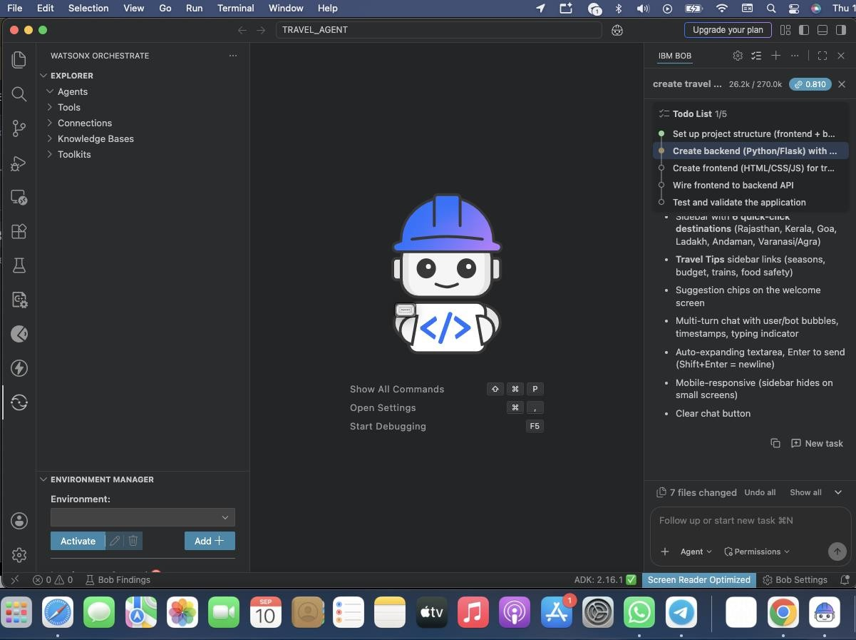
IBM Bob Screenshots:

Slide 8
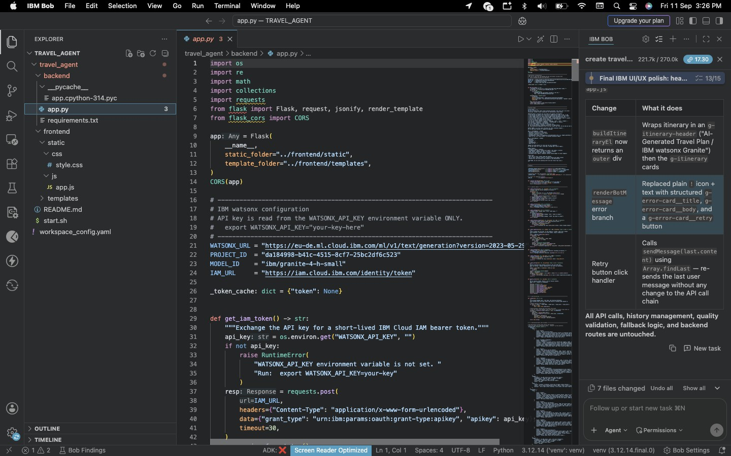

Slide 9
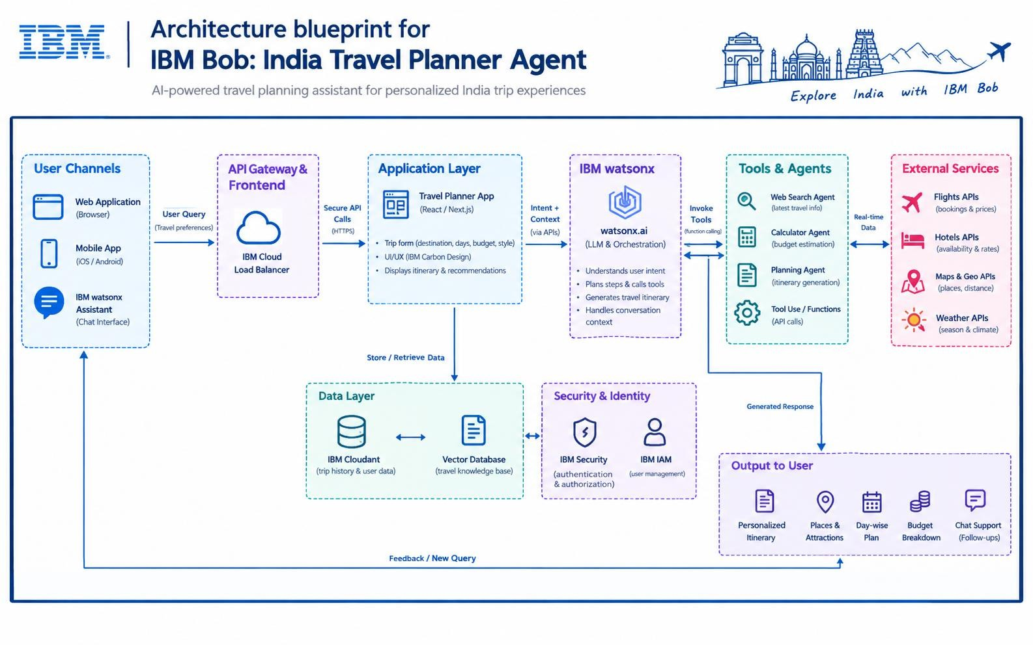
Architecture blueprint for IBM bob:

Slide 10

Role of Agentic AI in the solution
Role of Agentic AI in Travel Agent
Agentic AI enables IBM Bob to function as an intelligent and autonomous travel planning assistant rather than a simple chatbot. Using IBM watsonx.ai and specialized travel agents, it understands user preferences such as destination, duration, budget, and travel style to generate personalized travel plans. Each agent performs a specific role—such as searching attractions, checking weather, estimating travel costs, finding suitable hotels, and generating day-wise itineraries—while working together to provide accurate recommendations. The multi-agent approach enables efficient task execution and better decision-making. Agentic AI also provides context awareness, allowing IBM Bob to remember the conversation and adapt recommendations when users change their requirements. Through real-time tool integration, it can retrieve updated travel information and continuously optimize the itinerary. Overall, Agentic AI makes IBM Bob proactive, personalized, and goal-driven, providing users with a smarter and more convenient India travel planning experience.

Slide 11
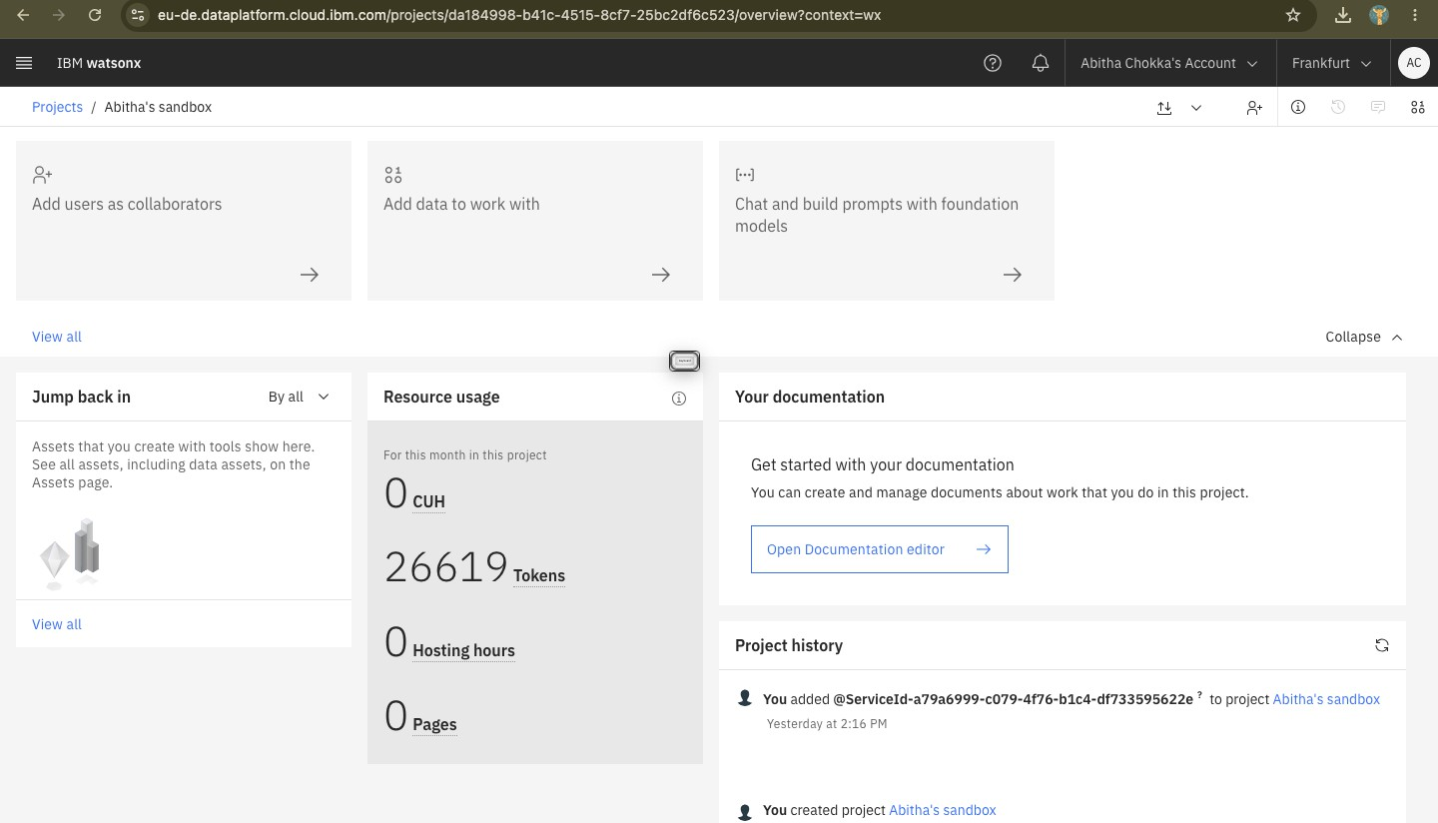
Token Usage
·
·
·

Slide 12
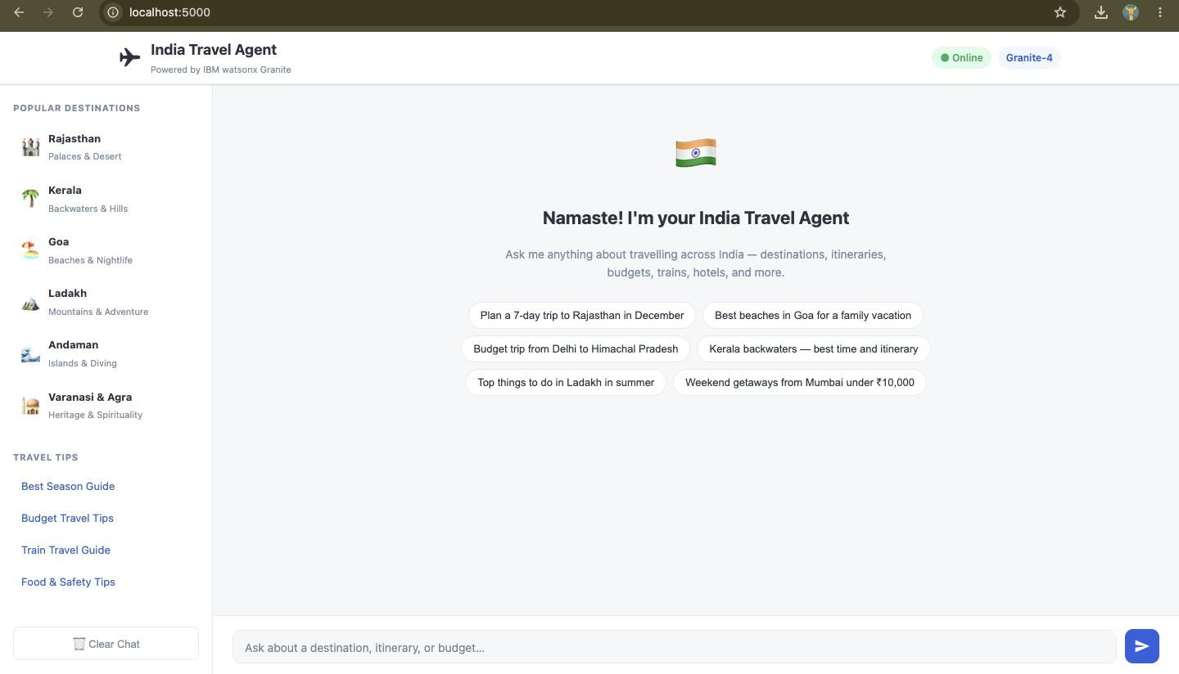
Project Output Screenshot
·
·
·

Slide 13
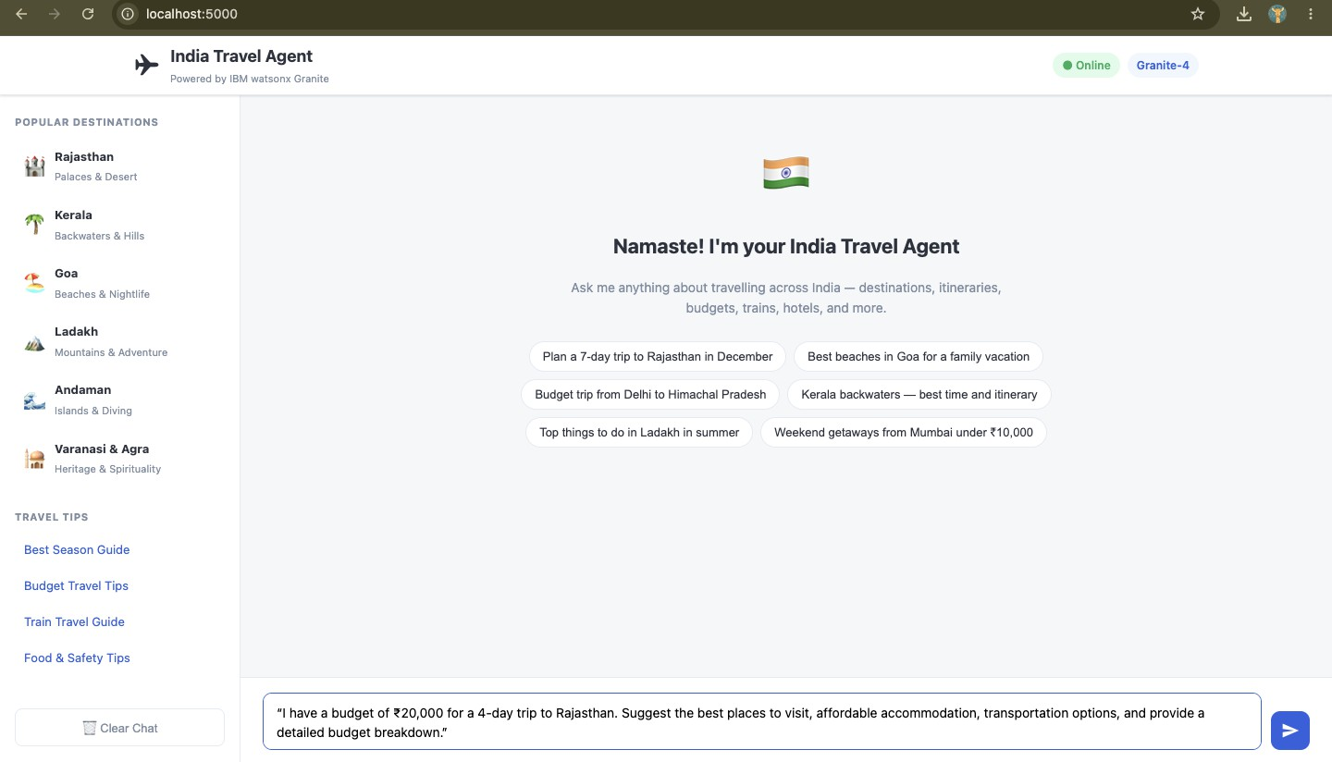
Project Output Screenshot
·
·
·

Slide 14
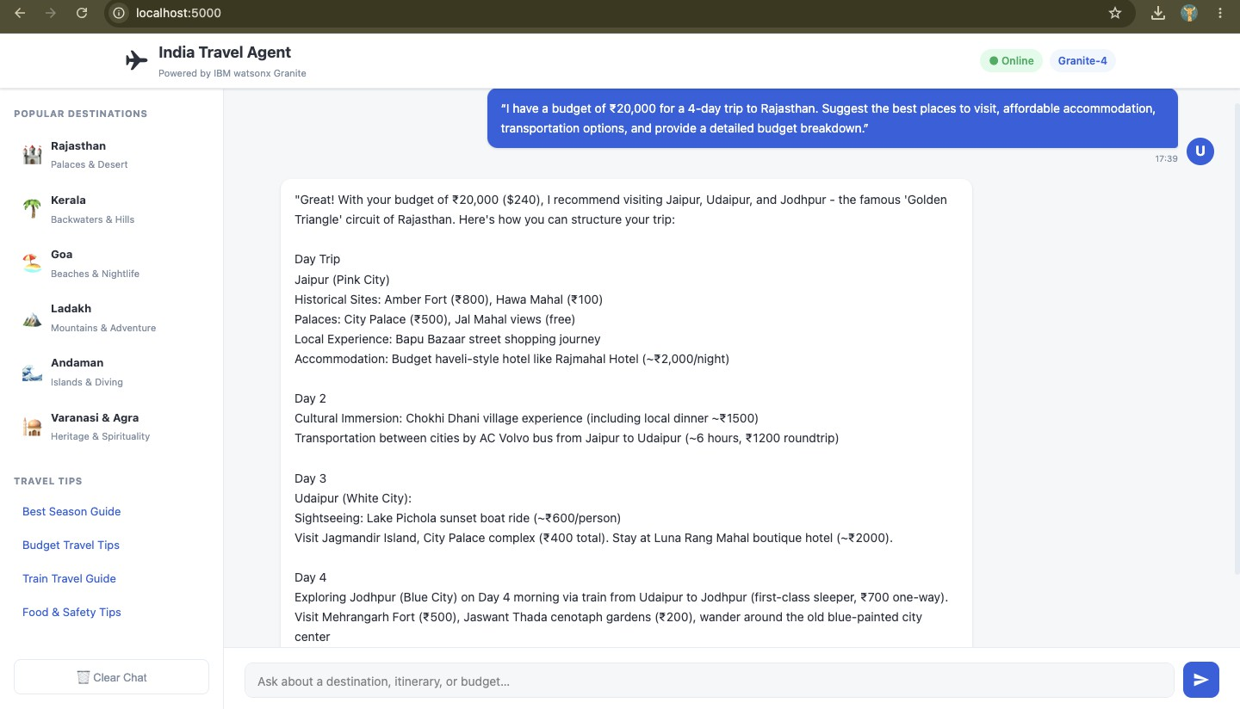
Project Output Screenshot
·
·
·

Slide 15
Novelty and Uniqueness
The proposed IBM Bob: India Travel Planner Agent stands out by combining Agentic AI, real-time information retrieval, personalization, and autonomous travel planning into a single intelligent system. Agentic Travel Intelligence – IBM Bob uses intelligent agents to understand travel requirements, plan tasks, and coordinate different travel-related activities.
Personalized Travel Planning – Generates customized itineraries based on destination, duration, budget, travel style, and user preferences.
Real-Time Information – Integrates travel-related tools and services to provide updated information about weather, attractions, hotels, routes, and travel options.
Budget-Aware Planning – Estimates expenses and provides a clear budget breakdown while suggesting
suitable travel options.
Multi-Agent / Tool-Based Approach – Specialized agents can handle tasks such as destination discovery, attraction search, itinerary generation, cost calculation, and travel assistance.
Conversational Adaptation – Users can modify their requirements through follow-up prompts, and IBM Bob
dynamically updates and optimizes the travel plan.
India-Focused Experience – Designed specifically for exploring Indian destinations, attractions, culture, food, transportation, and travel experiences.
IBM watsonx Integration – Built around IBM watsonx.ai capabilities to provide intelligent reasoning, orchestration, and conversational assistance.
Proactive Travel Assistance – Goes beyond static recommendations by helping users plan, refine, and
optimize their complete journey.

Slide 16
Git Hub Link
Git Hub Link
Public GitHub Repository: IBM Bob – India Travel Planner Agent
Working URL: GitHub
Repository includes: All Agent-relevant IBM Cloud/project files, Problem Statement
·PDF, Project Presentation PPTX, and other supporting files.
·
·

Slide 17
Future Scope
1. Real-Time Travel Data Integration –
The system can be enhanced by integrating real-time APIs for flights, hotels, weather, maps,
transportation, and tourist attractions. This will enable IBM Bob to provide more accurate and up-to-date travel recommendations.
2. AI-Powered Voice & Multilingual Support –
A voice-enabled assistant with support for Indian regional languages can be added, allowing users to interact naturally through speech and making the travel planner more accessible to a wider population.
3. Smart Booking & Reservation Support –
The system can be extended to connect with flight, hotel, and transportation booking services, enabling users to move from itinerary planning to actual reservations through a single platform.
  Dynamic Itinerary Optimization –
IBM Bob can continuously modify the travel plan based on weather changes, traffic conditions, budget changes, cancellations, and user preferences, providing a more flexible travel experience.
  Location-Based Recommendations –

Slide 18
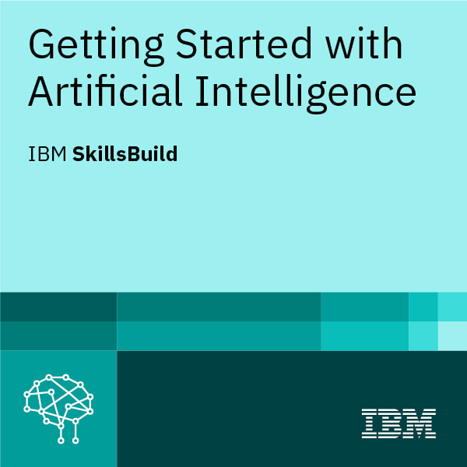
Certificates Earned:

Slide 19
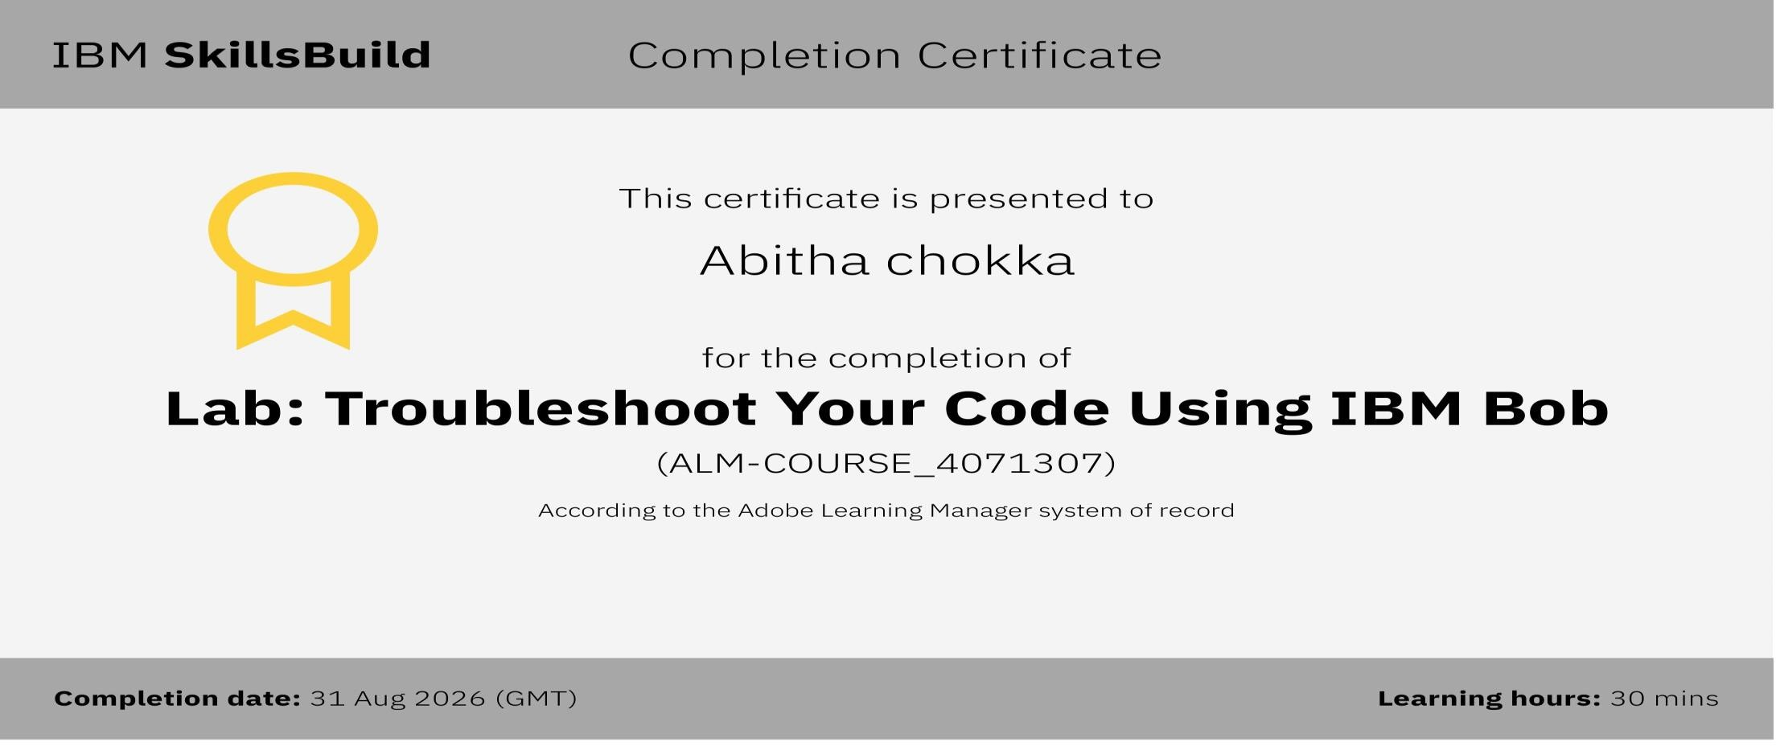
Certificates Earned:

Slide 20


